Slide 1
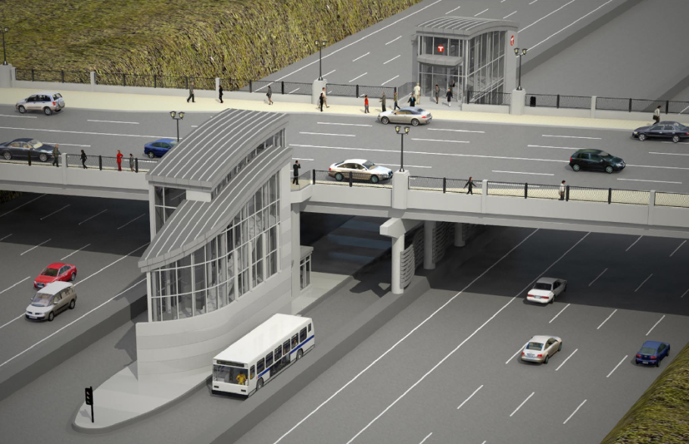
I-35W and 46th Street Station Concept Service Plan and Construction
John Dillery &
Mac Sweidan
Kingfield Neighborhood Association
June 2010

Slide 2
I-35W and 46th Street Station Concept Service Plan and Construction
Planning for the
Future – BRT
Concept Service
Plan
46th St Station
Public Input

Slide 3
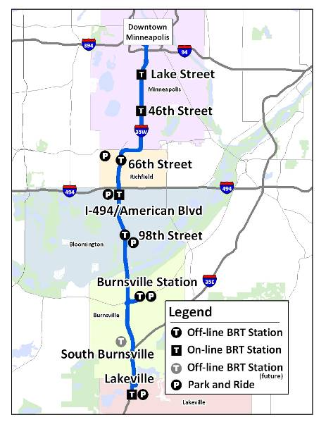
Planning for future BRT
Higher frequency
More destinations
Flexible and efficient
35W BRT coming in 2012

Slide 4
Purpose for I-35W and 46th St. Station:
A key part of the I-35W Bus Rapid Transit (BRT) plan
Provides access by bus rapid transit to:
South suburban locations (reverse-commute)
Downtown Minneapolis
The University of Minnesota
Major destinations east, north and west of downtown.
Facilitates reliable, comfortable and convenient
transfers between I-35W and cross-town bus lines.
Notes:
Major destination s east, north and west of downtown, (Roseville, S. Louis Park, Golden Valley) would be served in the long-term (2020?) by new direct commuter routes.

Slide 5
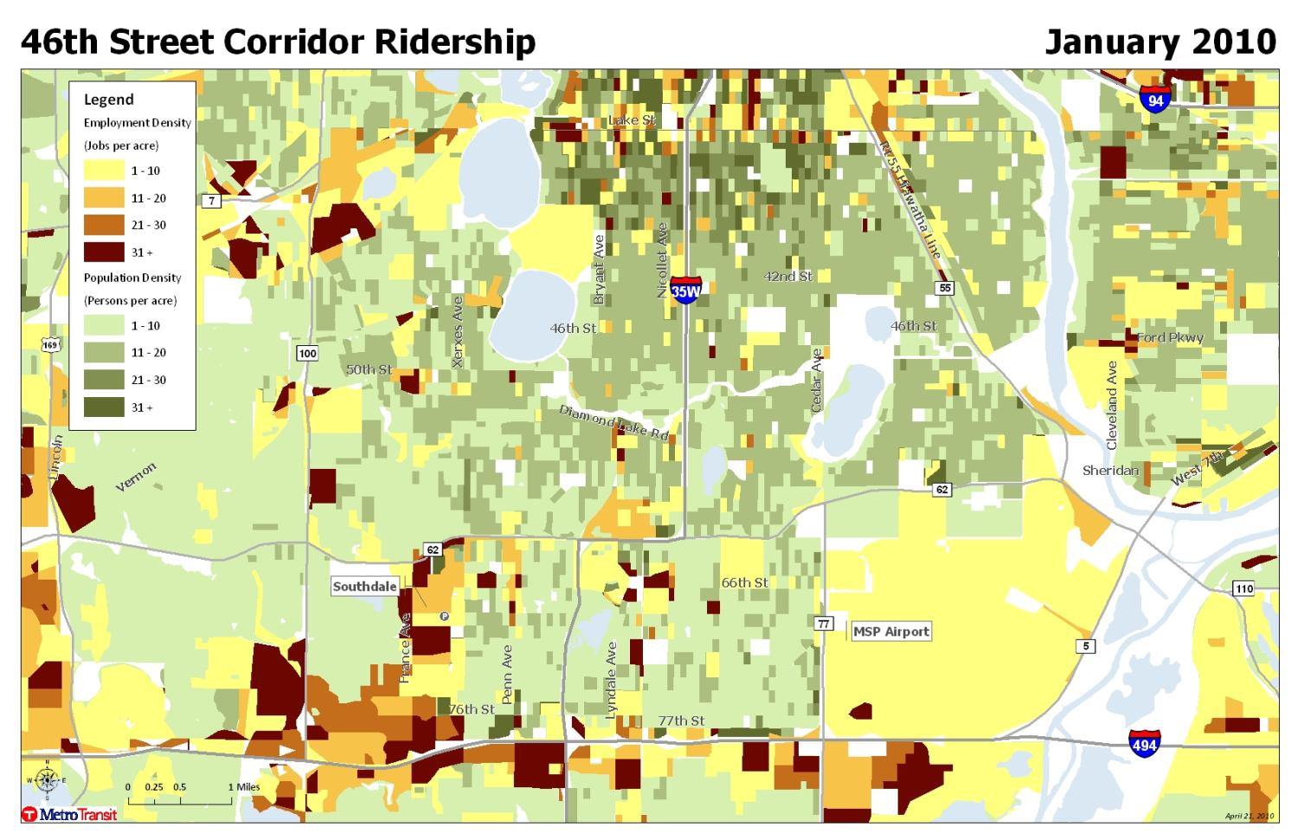
46th Street Corridor Population and Employment
T
January 2010
Notes:
Rt 46 Weekday rides in early 2010 = 833
Rt 146 Weekday rides in early 2010 = 565, but used to be higher. Before construction of I-35W / Hwy 62 and Marq2 daily rides exceeded 800.
Rt. 152 Weekday rides in early 2010 = 144, but used to be higher before construction of I-35W / Hwy 62 and introduction of Rt 579 Southdale – U of M express.

Slide 6
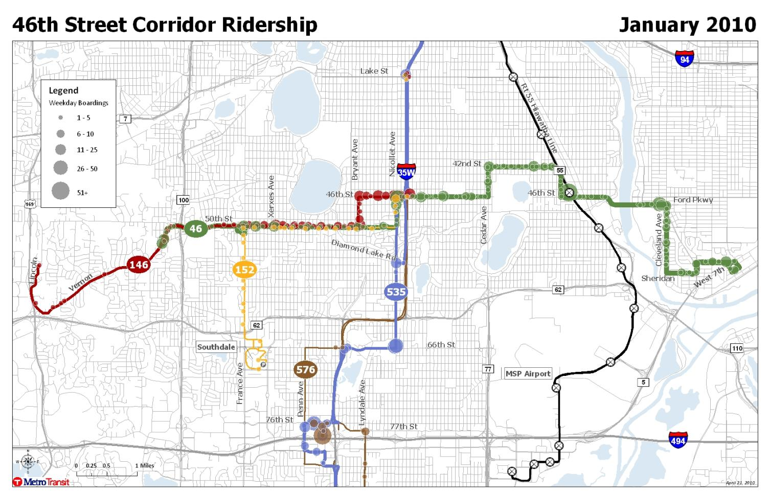
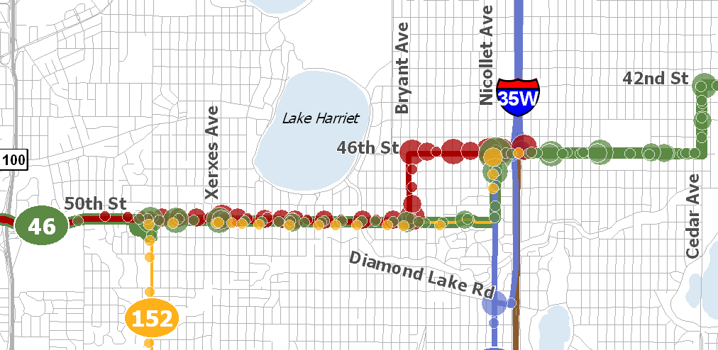
46th Street Corridor Routes and Ridership
46th Street Corridor Routes and Ridership
January 2010
Notes:
Rt 46 Weekday rides in early 2010 = 833
Rt 146 Weekday rides in early 2010 = 565, but used to be higher. Before construction of I-35W / Hwy 62 and Marq2 daily rides exceeded 800.
Rt. 152 Weekday rides in early 2010 = 144, but used to be higher before construction of I-35W / Hwy 62 and introduction of Rt 579 Southdale – U of M express.

Slide 7
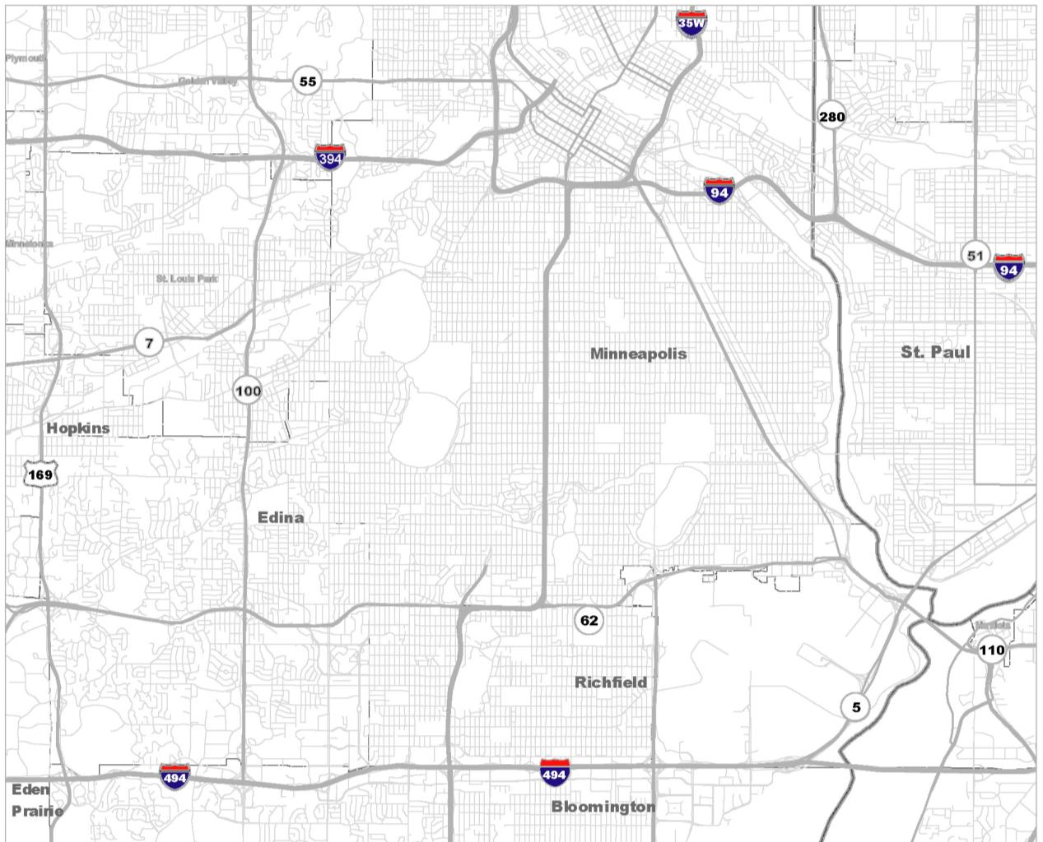
Route 135
  No-transfer for current 50th St customers
  Improve service to every 15 minutes, extend to Edina, Eden Ave /Vernon via W. 50th St.
Route 152
  W. 50th St service replaced by Rt 46 connection at 35W
  Faster trip for U of M customers boarding at Southdale via Rt. 579
  France Ave eliminated – low ridership
Route 156
  Replace Diamond Lake Rd/35W stop
  Shuttle service to I-35W and 46th St. Station
  Create reverse-commute connection for Lyndale Ave employers
I-35W and 46th St Station
Concept Plan
Route 535
  Every 15 minutes during rush hour
  Replaces Routes 146 & 576 on 35W
  Faster travel time on MnPASS HOT lanes
  Routes 578, 597, 684 provide additional options for reverse commutes
Route 46
  Every 15 minutes during rush hour between France-Hiawatha Ave
  Replaces Routes 146, 152 on 50th St

Slide 8
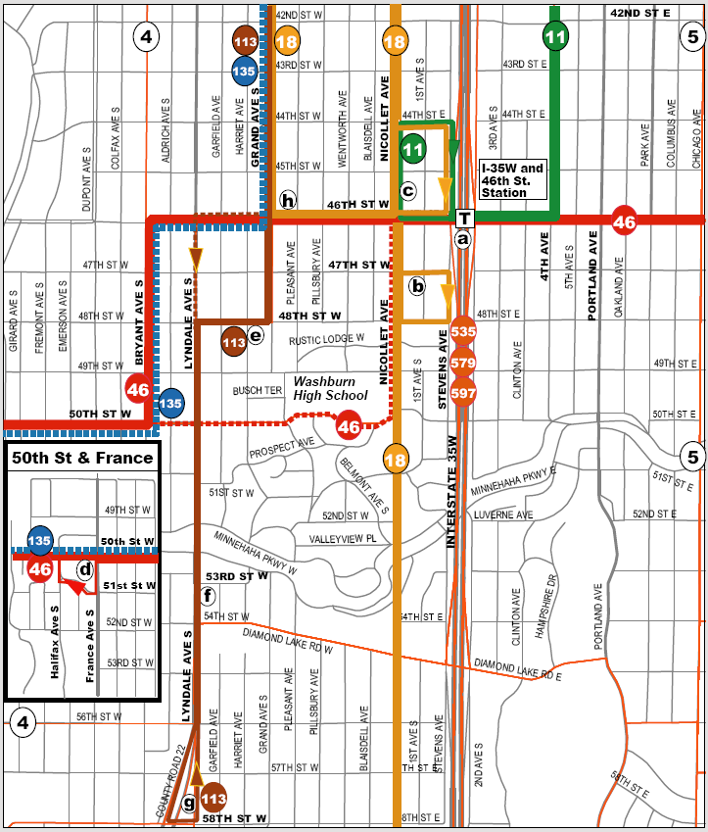
New connections to I-35W and 46th St. Station
Way-finding signage
Turnaround & layover changes
Increased: (a) – Rt. 11 - 4th Ave, (c) – Rt. 18 – Grand Ave
(g) – Rt. 113
Discontinued:
(f) – Rt. 113 (h) – Rt. 135
Reduced usage:
(e) – Rt. 113
Stable usage:
(b) – Rt. 18
(d) – Rt. 46
Notes:
Way-finding signage is recommended for Route 18 riders coming from Nicollet Avenue so that they are directed to and from the I-35W and 46th St. Station.

Slide 9
Passenger Experiences, Urban & Suburban
50th St/France Ave to Downtown or U of M:
Existing Time Frequency
No transfers.
Rt 146/152 28 minutes 15-30
Proposed
A 5-minute transfer at new climate-controlled station, or no transfer via Rt 135.
Rt 46 to 535/579, or 135 31- 33 minutes 7.5-30
46th St/Chicago Ave to Golden Triangle in Eden Prairie:
Existing Time Frequency
2 transfers: a 20-minute@ France & 50th (no shelter), and a 10-minute @ Southdale (heated shelter).
Rt 46 to Rt 6 to Rt 684 74 minutes 60
Proposed
One 10-minute transfer at climate-controlled I-35W and 46th St. Station
Rt 46 to Rt 684 42 minutes 15-60
Notes:
Proposed travel times are approximate.

Slide 10
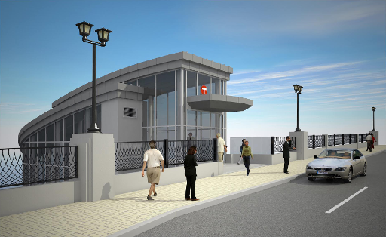
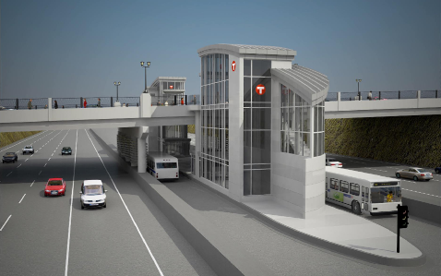
I-35W and 46th St. Station Design Elements
Safety/Security
Environmental
Customer amenities
Real-Time information
Notes:
STATION is Opening with December 2010 Service Changes.

Slide 11
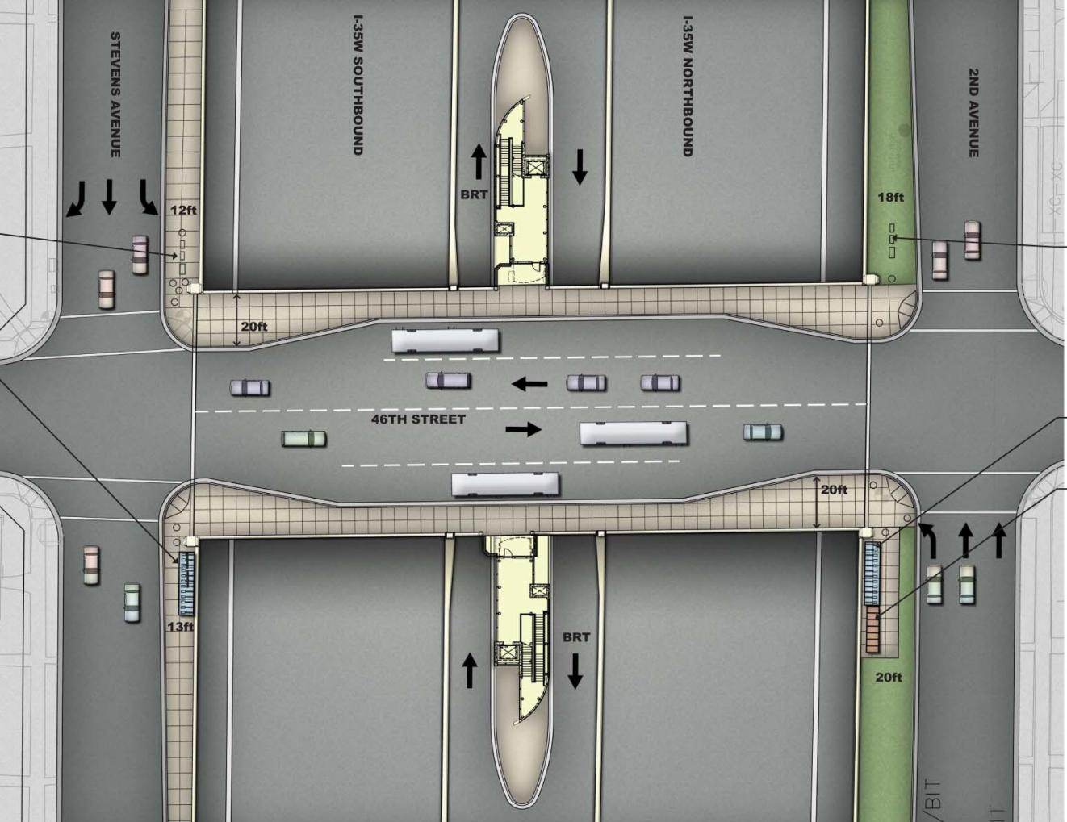
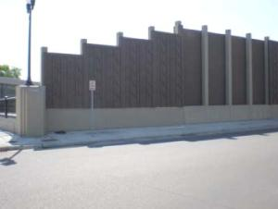
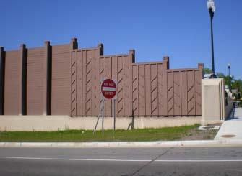

Slide 12
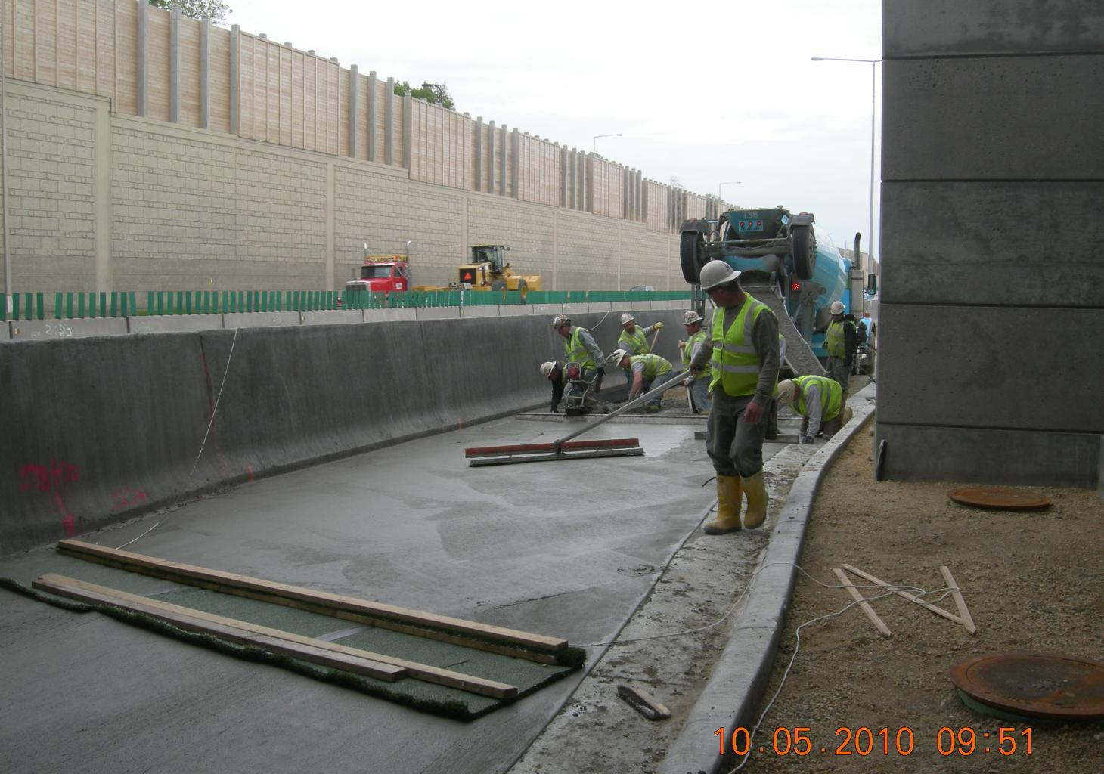

Slide 13
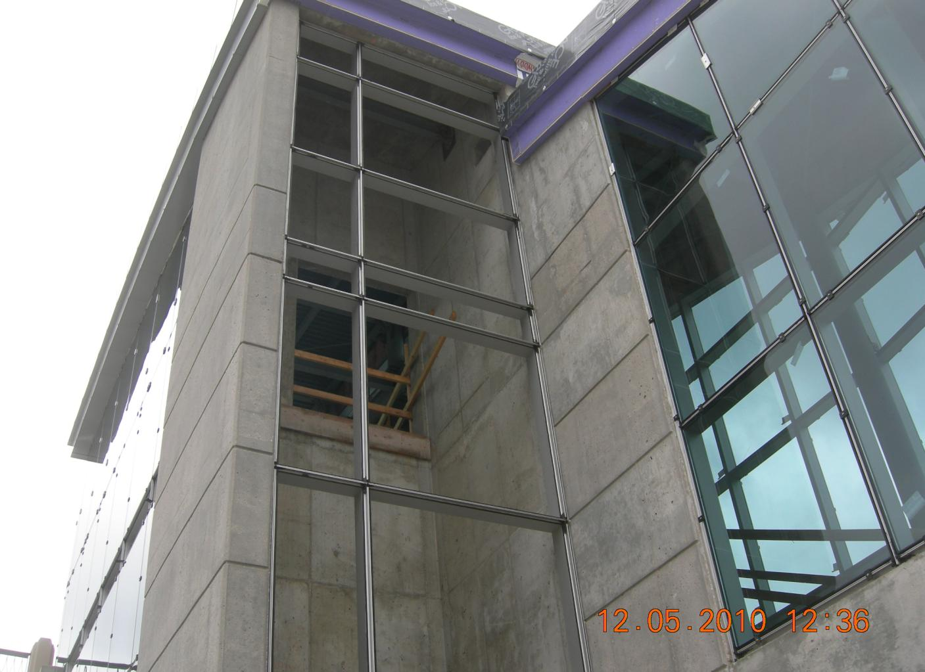

Slide 14
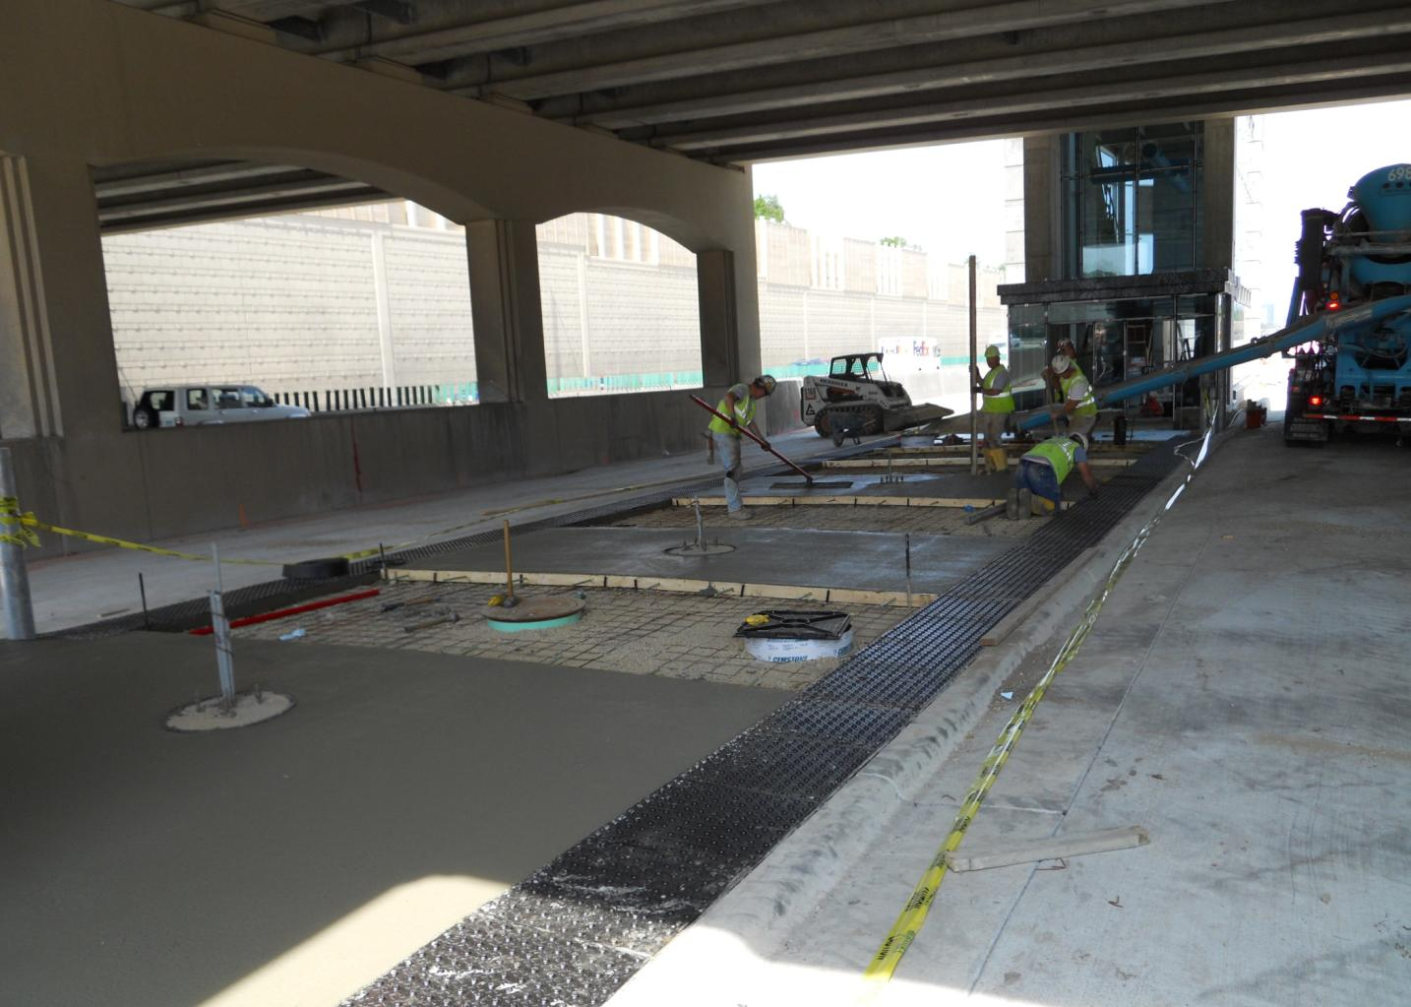

Slide 15
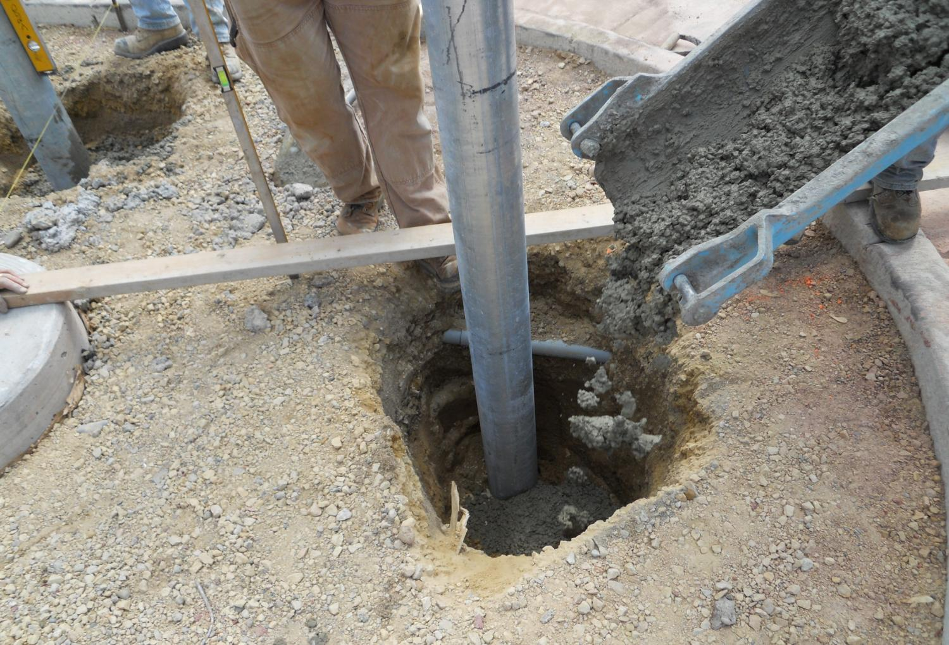

Slide 16
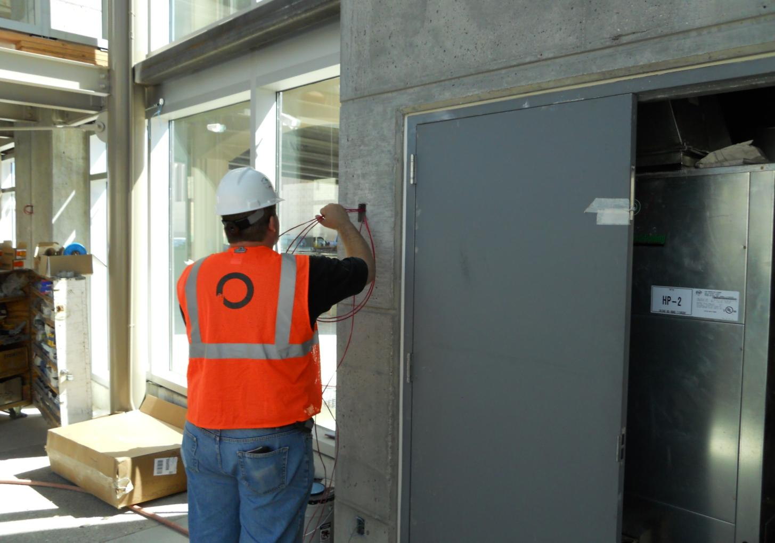

Slide 17
Next Steps
June: Public meetings
Comments via website, email, fax, data center thru July 9, 2010
July: Concept plan
modification
August: Met Council
final approval
December: Implementation
Tuesday, June 15th, 5:00 – 7:00 p.m.
Public Informational Meeting
Fuller Park
4800 Grand Ave. S
Minneapolis, MN 55419
Tuesday, June 29th, 11:30 – 1 p.m.
Public Hearing
Minneapolis Central Library
300 Nicollet Mall
Minneapolis, MN 55401

Slide 18
Thank you. Questions?
www.metrotransit.org/35W-BRT/
Send comments to:
35W-BRTstation@metc.state.mn.us

