Slide 1
911 Burglary Prevention & Property crimes Investigations
MECC/911 Supervisor Maryam Williams
5th Precinct Property Crimes Lt Lee Edwards
Crime Prevention Specialists Amy Lavender & Chelsea Adams

Slide 2
Mecc 911 presentation
Maryam Williams

Slide 3
Nine helpful tips when calling 911
Video from MECC/911

Slide 4
Fifth Precinct burglary prevention
CPS’s Lavender & Adams

Slide 5
Burglary prevention
In most cases home burglary is a crime of opportunity
Residents can minimize their vulnerability to opportunistic burglars by reducing or eliminating opportunity
Enhancing security can be easy. Investing a little time and money now by taking preventive steps can save thousands of dollars in the long run.
Watch a video of a chronic burglar describing what he looks for when determining a place to burglarize.

Slide 6
burglar VIDEO
Video of convicted burglar’s explanation of what he looks for when targeting homes

Slide 7
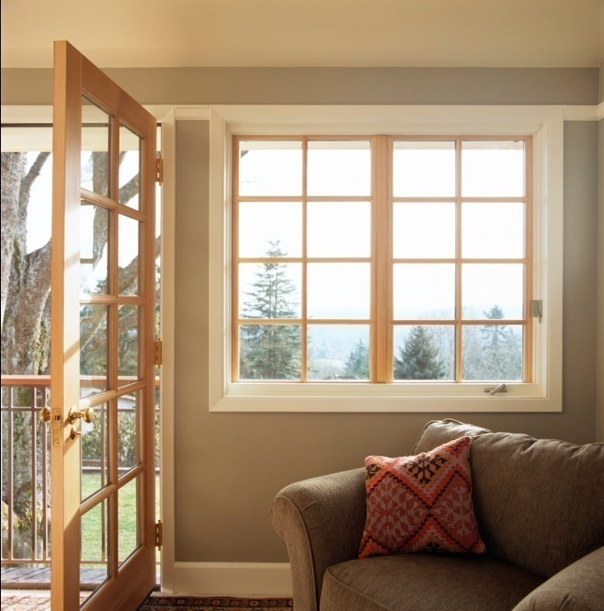
Sources of Opportunity
Open, unlocked, or poorly secured doors and windows (vehicles, garages, homes, etc)
Poorly secured or unsecured items like bicycles
Visible valuables (in home, car etc)
Unwatched or poorly lit areas with poor natural surveillance
Places where criminals know no one will watch or call on suspicious activity

Slide 8
Common M.O.’s
Spring/summertime: open or unlocked windows are easily compromised by slitting the screens, pushing open the window, and entering the home.
Most residential burglaries occur during the day.
Most garage burglaries occur overnight.
Common entry: unlocked, open, or poorly secured door
Most burglaries are a crime of opportunity.
Most burglars do NOT want to confront anyone.
Home invasions, as seen on TV, are very rare.

Slide 9
recommendations
Fences and Landscaping
Lighting and neighbors
See-through fences (not privacy fences)
Trim hedges/shrubs at 3-4 feet, tree canopies at 6-7 feet
Hostile vegetation in/near large egress windows
Dusk-till-dawn lights on entries
Motion lights: specify usage to neighbors
Tell neighbors to call 911 on suspicious activity

Slide 10
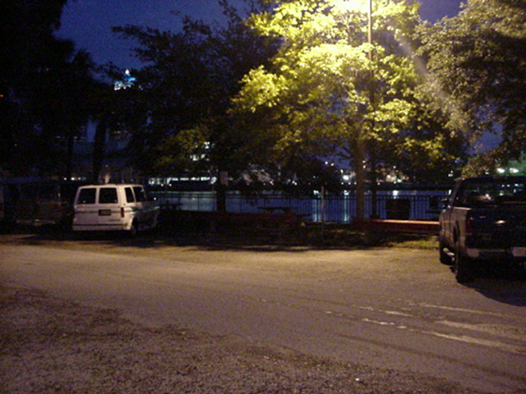
Lighting and glare
Do you see the person on the bench beneath the tree?
Use covered lights to avoid glare
The human eye takes 20 minutes to adjust between light / dark
Check placement of lighting to avoid large dark spots

Slide 11
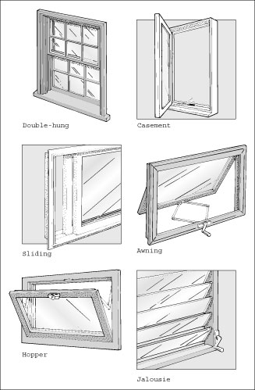
Building Exterior
Windows : popular point of entry for burglaries.
Any window 18 feet or less above ground should be considered a potential easy access point
Types of Windows:
Double Hung (common; push upward; older homes have pulleys)
Jalousie/louvered (slats which tilt open; difficult to secure)
Casement (use crank to open outward)
Awning (like sideways casement; opens outward to allow breeze)
Hopper (opens inward; often in basement)
Glass Block/Brick (often in basements; very secure; allows lighting, ventilation, no opening)
Sliding (slide open like sideways double hung)
Picture from housekeepingchannel.com

Slide 12
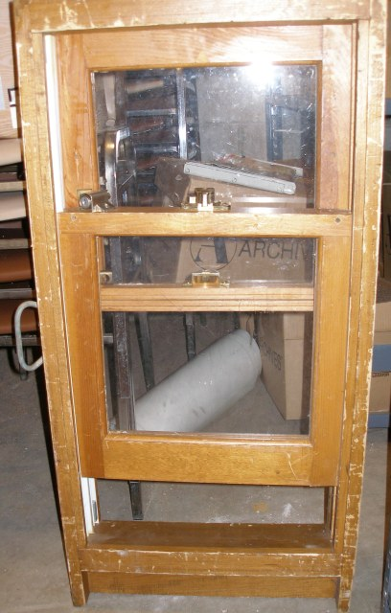
Window locks
Double Hung Windows
The type of lock used depends on the window. Most Minneapolis homes have double hung windows.
Pin the window so it can’t open more than 6” for security. (Especially ground level windows)
Any pinning option allows for the window to open fully or close fully by removing the pin or flipping the lock
Pinned double hung window opened 6” for ventilation. This is secure.
pinning a double hung with a nail

Slide 13
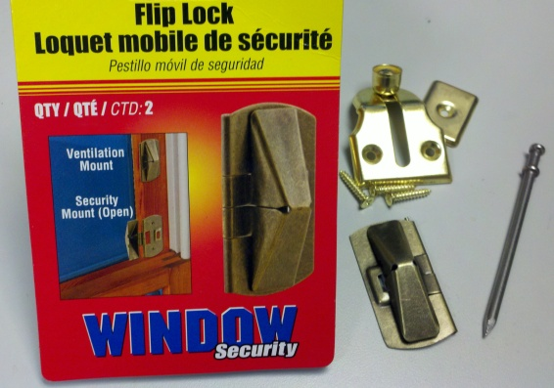
Double hung window locks
Locks are placed in the track or frame.
Any of these items can be found at your local hardware store.
Only one lock required per window
These are important to use in the summer/spring
Shown from top to bottom: window vent stop/brass
sash stop, flip lock, and nail for pinning a window.

Slide 14
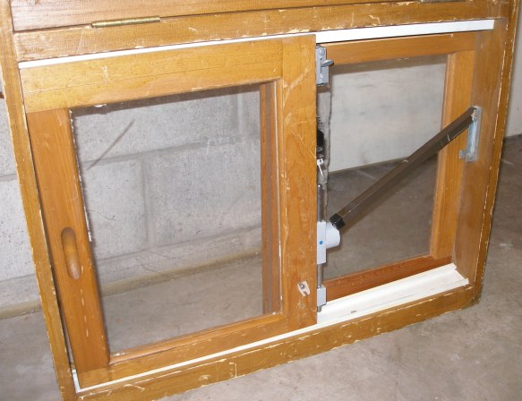
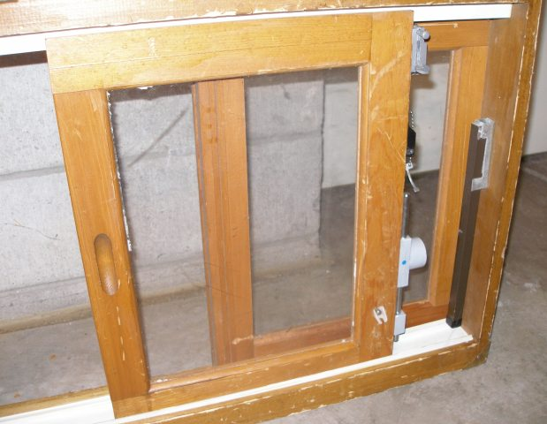
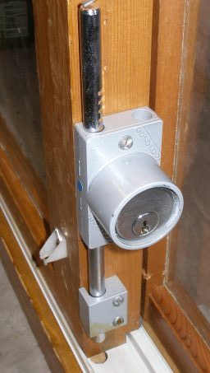
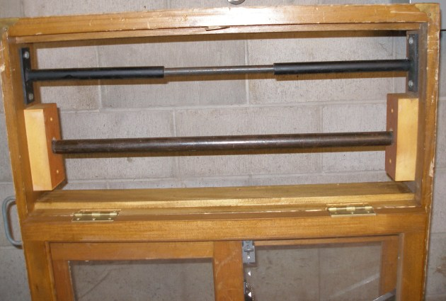
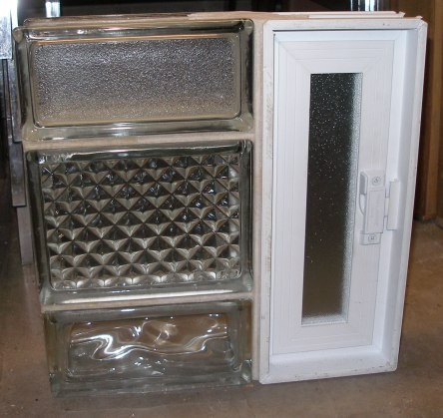
Interior controls
Other Windows & Locks
Sliding window closed, locked. Charley bar and other locks shown.
Pinned sliding window opened 6” for ventilation. This is secure.
Close up of a lock.
Different versions of glass block/glass brick shown.
Ventilation shown on the right.
Glass block is the most secure window and is a great option for areas of concern in a basement.
Remember: It does NOT meet fire code for bedrooms because it does not allow for egress.
Open hopper window. Bars can be used to secure.

Slide 15
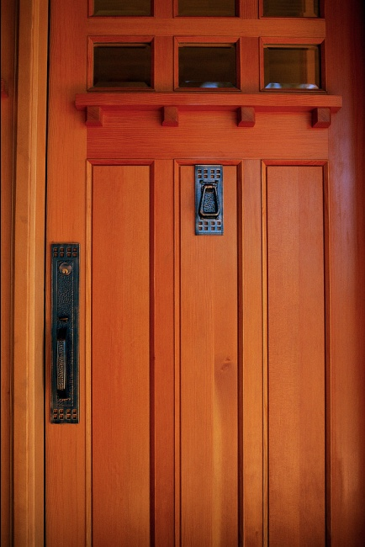
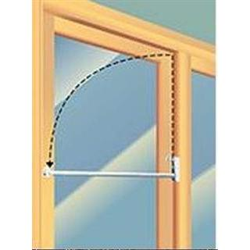
Doors
Frames should be heavy metal
Hinges should not be exposed
Outside doors should be solid
If there are windows within 40” of the lock, consider:
double or triple pane windows
shatter-resistant window film
or double cylinder lock
Sliding doors should have flathead screws installed in the upper track and a charley bar to prevent the lifting and removal of the door panel.
To increase the safety of your door, consider a high security strike plate.

Slide 16
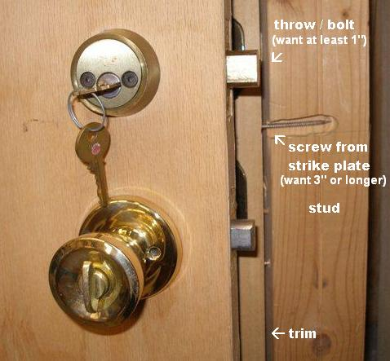
Anatomy of a door
Deadbolts are recommended.
Check to ensure:
the throw (bolt) is at least 1”
Screws on the strike plate are a least 3” and extend into the stud.

Slide 17
Double vs single cylinder deadbolt
Single cylinder
Double cylinder
Most commonly recommended lock
Extra security for doors with glass
Safety hazard in case of fire
Not recommended for homes with elderly, children, or vulnerable adults

Slide 18
Fifth Precinct Property crimes Investigations
Lt Lee Edwards

Slide 19
Property crimes information
How are property crimes investigated in Fifth Precinct?
Report routed to unit
Assigned
investigated
charged
Not assigned
Can assign with evidence
Officer report
Lt reviews for evidence
Outcome

Slide 20
Questions?
Maryam Williams MECC/911 Supervisor
(citywide)
612.348.2345
Maryam.Williams@minneapolismn.gov
Amy Lavender
Crime Prevention Specialist
5th Precinct
612.673.5407
Amy.Lavender@minneapolismn.gov
Lt Lee Edwards Property Crimes Lieutenant
5th Precinct
612.673.5592
Lee.Edwards@minneapolismn.gov
Chelsea Adams
Crime Prevention Specialist
5th Precinct
612.673.2819
Chelsea.Adams@minneapolismn.gov

