Slide 1

Overview of Sidewalk Inspections
2000 miles of sidewalk in Minneapolis public right of way
3 Sidewalk Inspectors
Oversee the Sidewalk Repair Program which replaces approximately 300,000 sq ft of concrete each year
Our program inspects sidewalk at 2500 – 3500 properties each year
Issue permits and inspect all other sidewalk repair/replacement in Minneapolis public right of way (600+ each construction season)
Receive and address all sidewalk related 311 questions (1000+ each construction season)

Slide 2
Criteria
Public Works Department performs inspections of sidewalks to identify defects and hazardous conditions that exceed the minimum criteria for removal and replacement.
Defective Criteria
  Cracked or Broken Sidewalk
  Uneven or Settled Sidewalk
  Projecting Sidewalk
  Other Sidewalk Defects or Conditions

Slide 3
What Residents Can Expect
The concrete panels that have been marked in white paint will be removed
6-12 inches of soft surface may be disturbed adjacent to the panels
  Any plants or items that may be disturbed should be moved by the property owner
  Irrigation heads should be delineated
Concrete will be poured and will be able to be walked on within 24-48 hours
Soft surfaces will be restored with dirt and grass seed unless otherwise discussed

Slide 4
Process
Select areas of Minneapolis to replace sidewalk
Review for other projects that may conflict with this program
Hire the lowest responsive bid contractor
Walk the entire area marking defective sidewalk
Measure the sidewalk panels to be replaced and document
Take pictures of every site
Notify property owners by letter the sidewalk will be replaced. They can hire their own contractor or use the one we have.
If residents have any questions they can contact the Sidewalk Department
Direct contractor to do the work

Slide 5
Process continued
If the property owner disagrees with work that was completed there is a formal process to appeal.
For all properties that do not pay the invoice by November 15th of the following year. The balance is added to their taxes as a special assessment.
  Example: sidewalk replacement work completed July 15th 2026. An invoice will be mailed in early 2027. If that invoice is unpaid by November 15th of 2027 the balance due will be added to the 2028 property taxes as a special assessment.

Slide 6
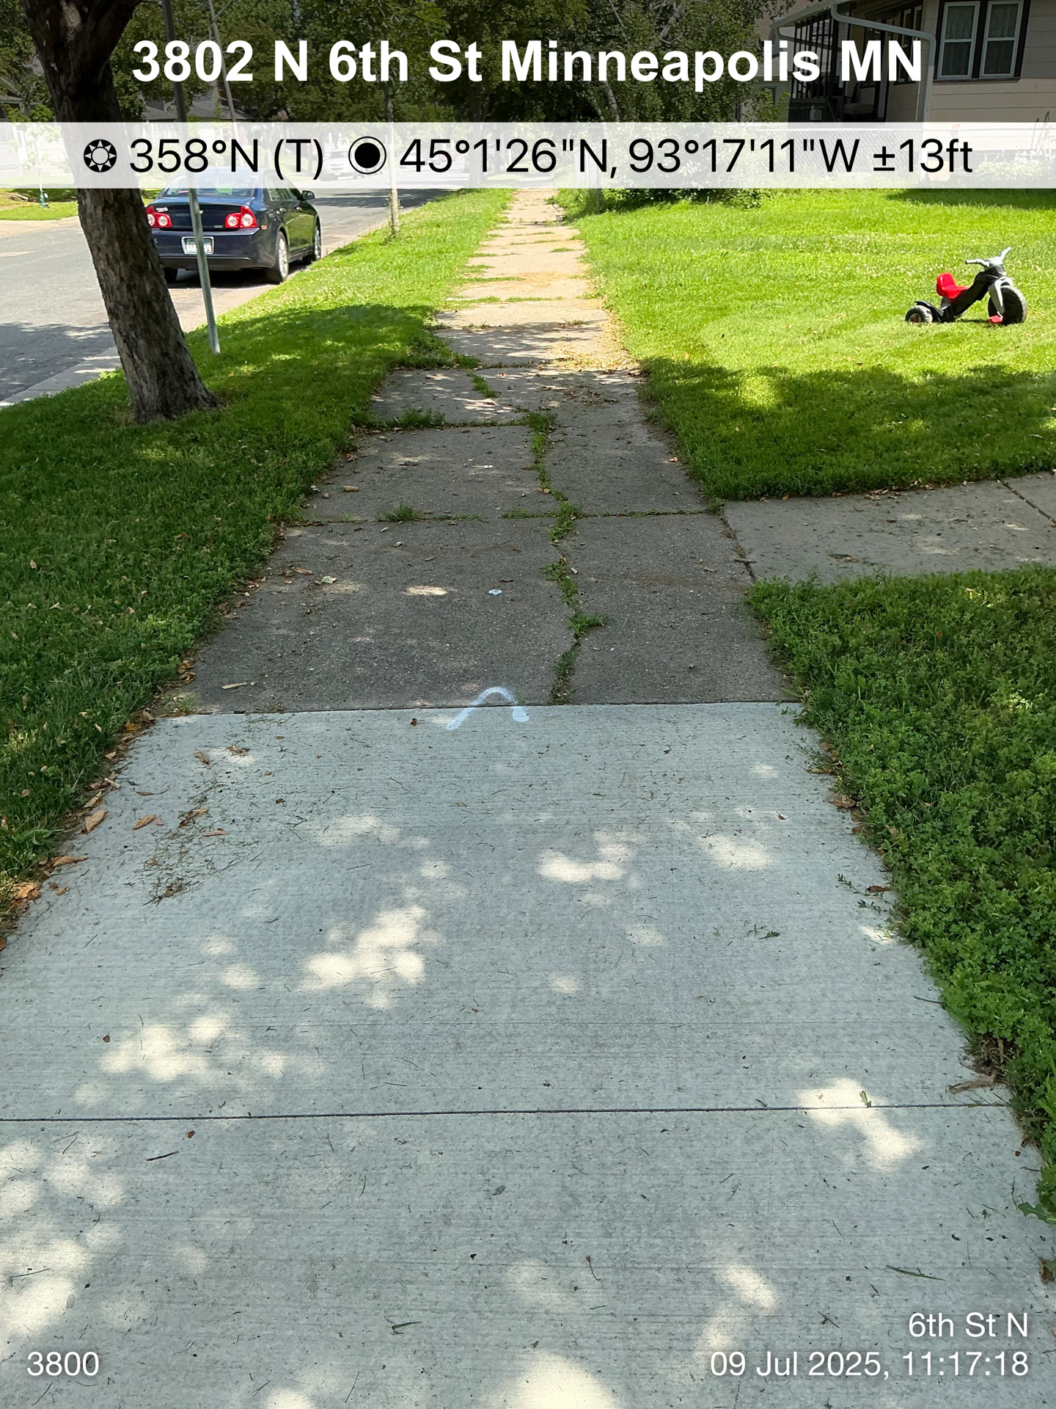
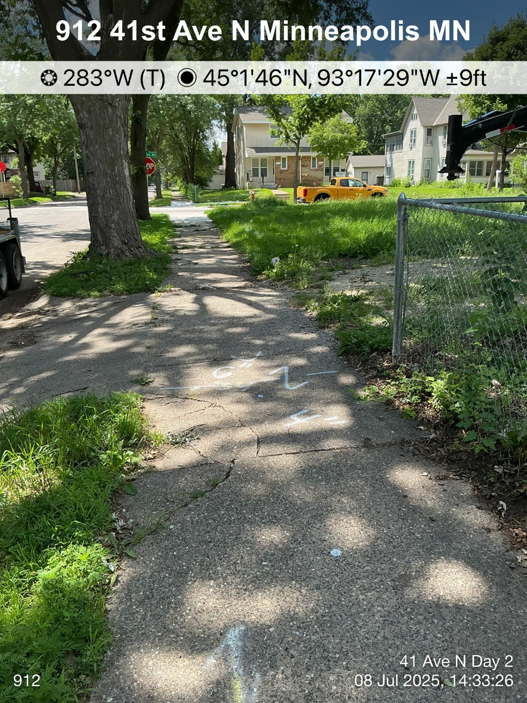
Cracked or Broken Sidewalk

Slide 7
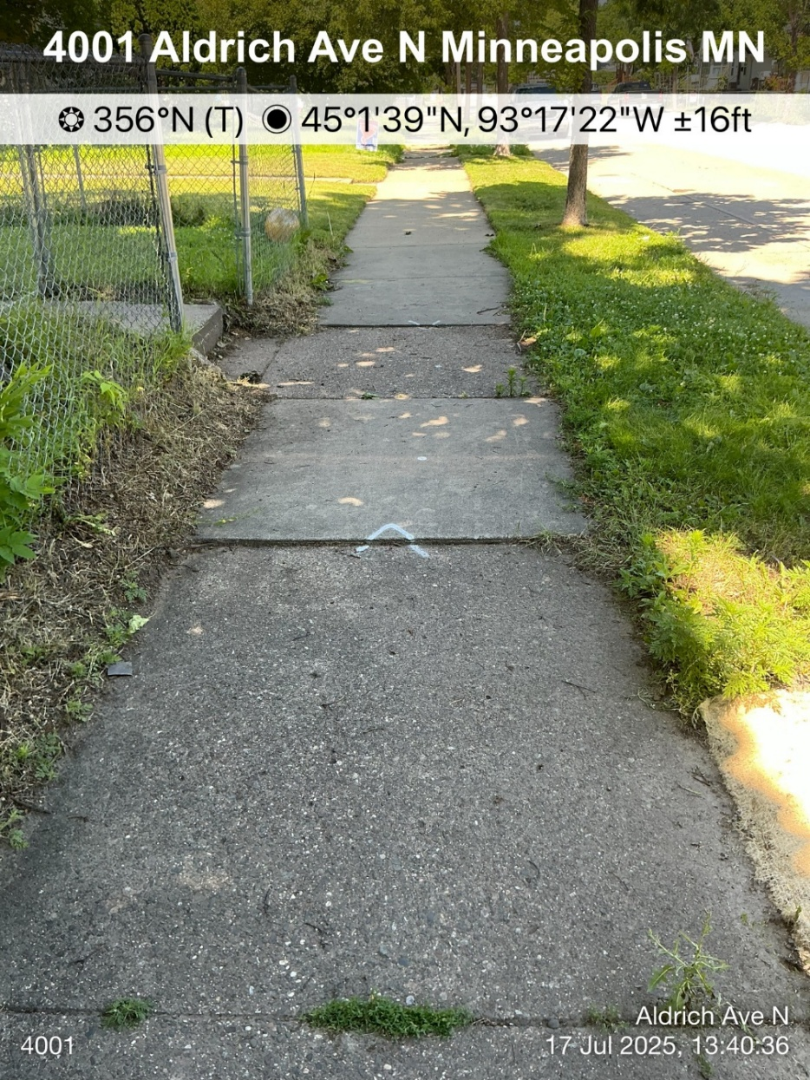
Uneven or Settled Sidewalk

Slide 8
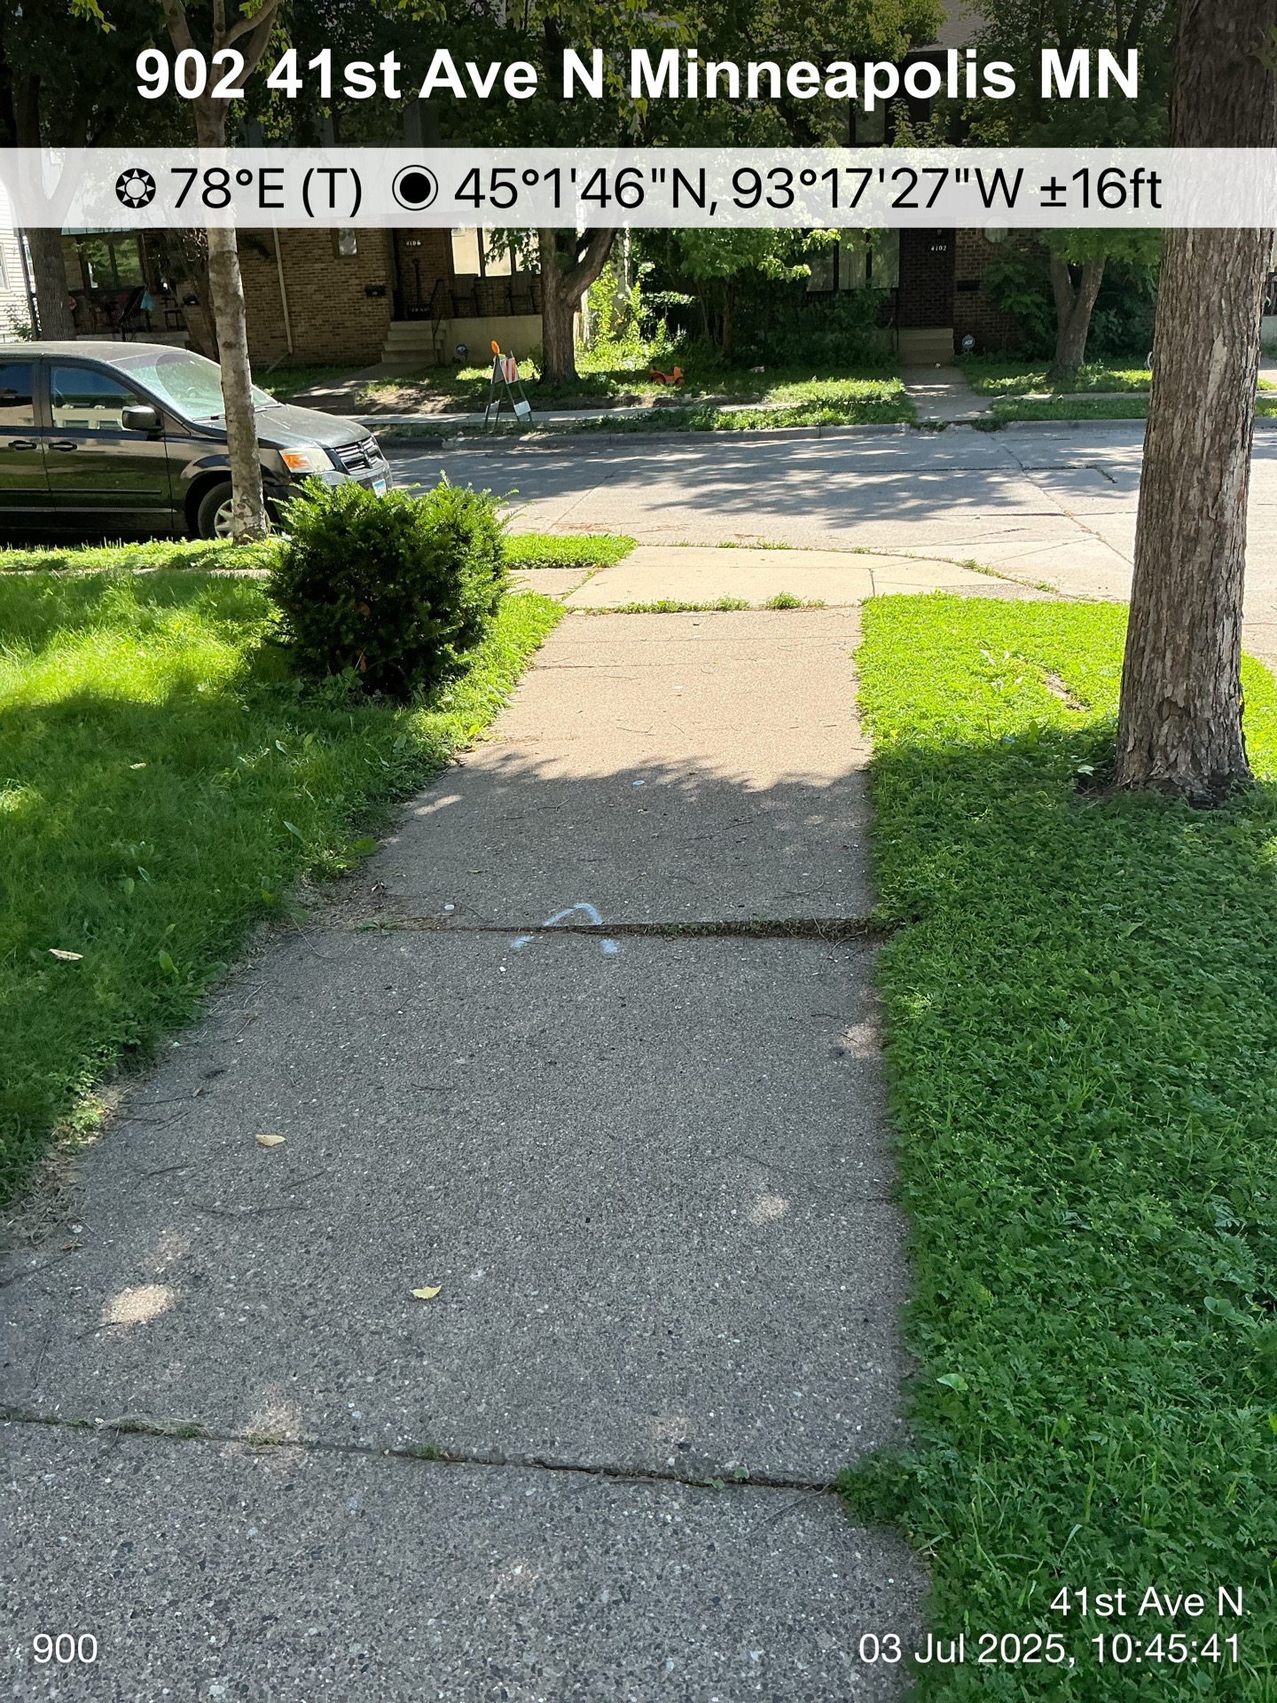
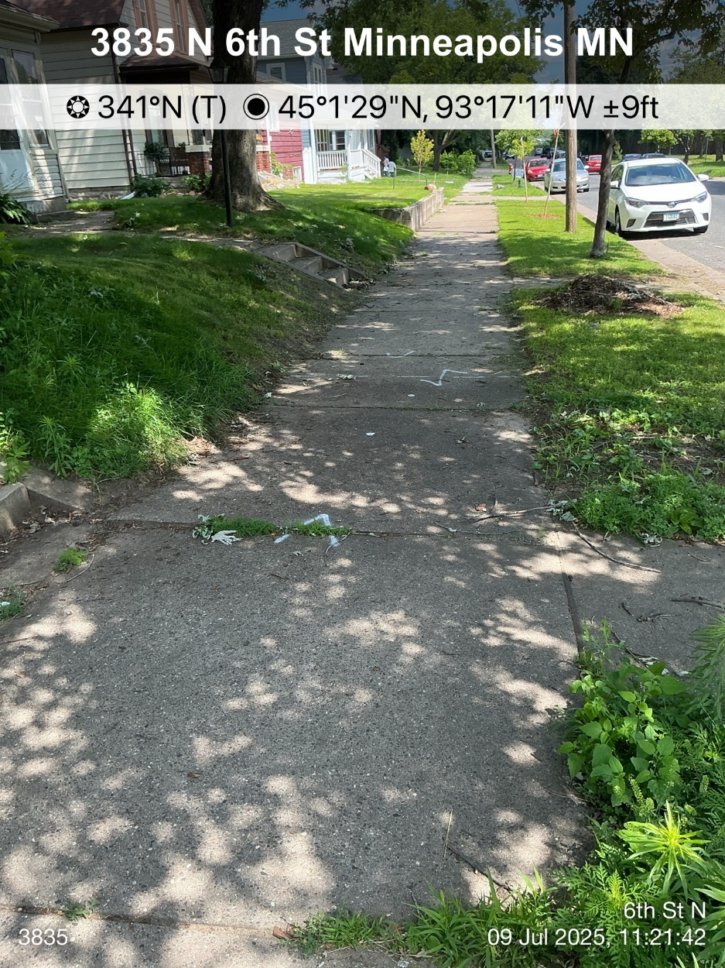
Projecting Sidewalk

Slide 9
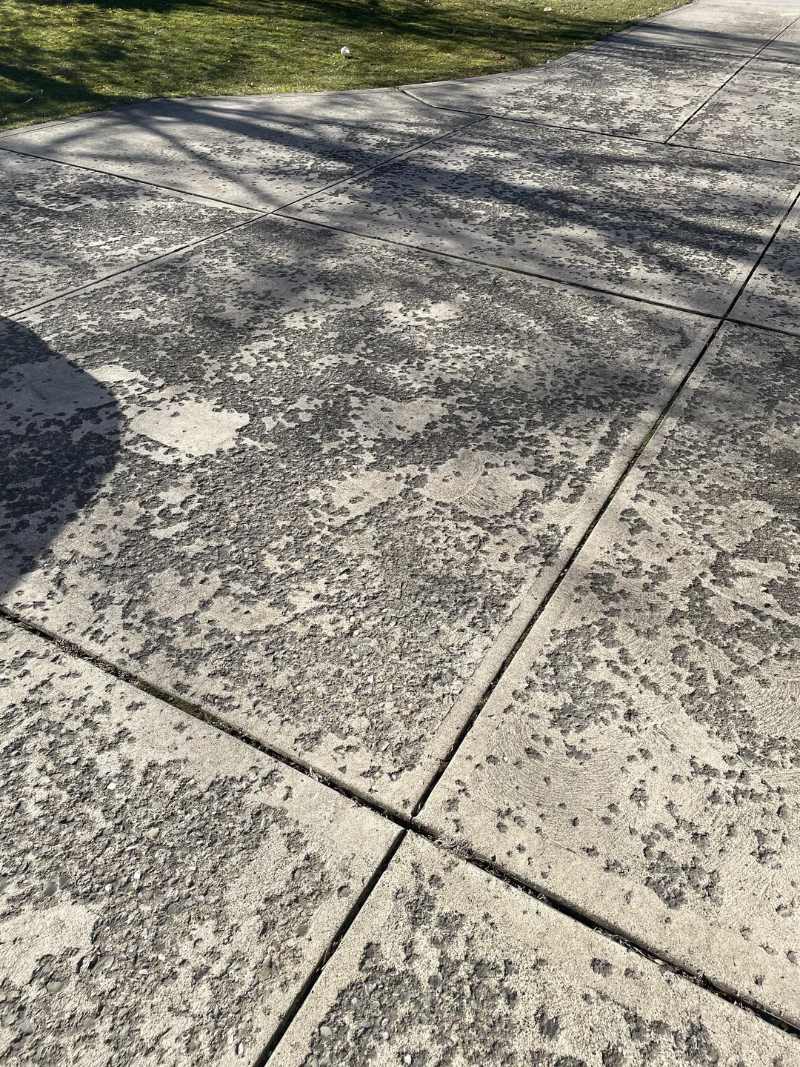
Other Sidewalk Defects

Slide 10
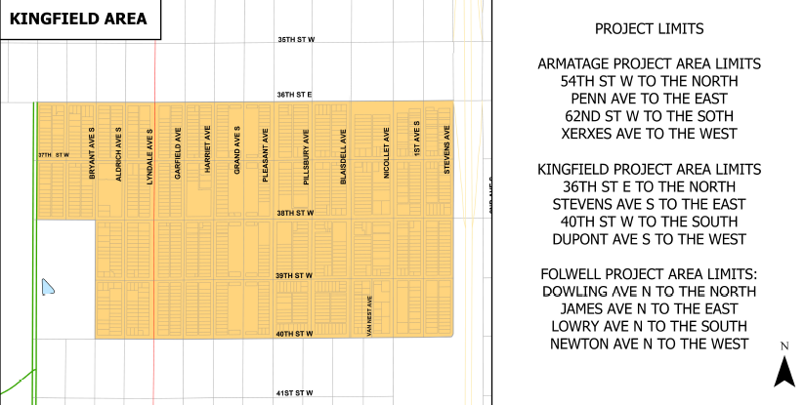
Kingfield Sidewalk Replacement Area
Early-Mid September Start
Duration 1 month
Starting on Stevens Ave moving west
Start time for work each day is 7am
Notes:
Add future area map

Slide 11
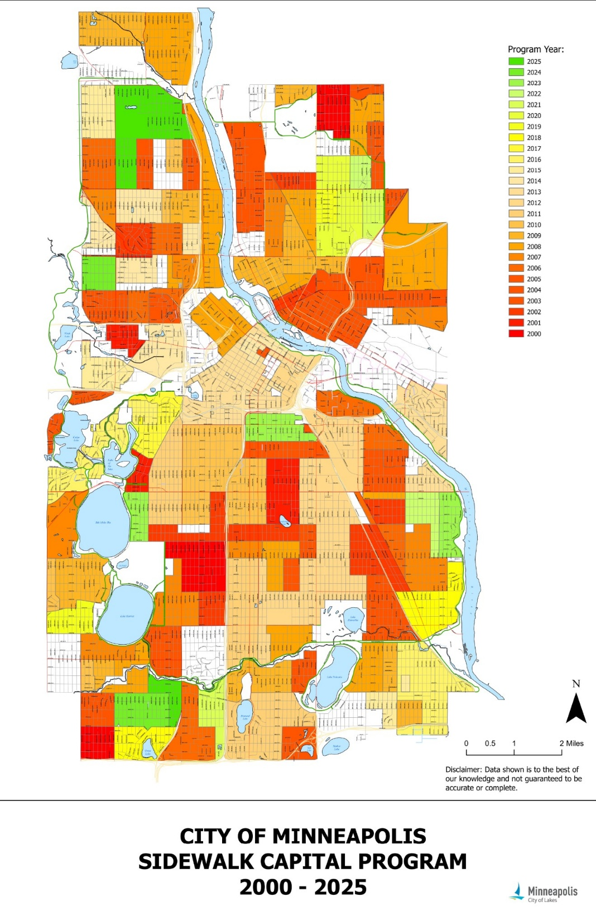
Historic Sidewalk Repair Program
Notes:
Add future area map

Slide 12
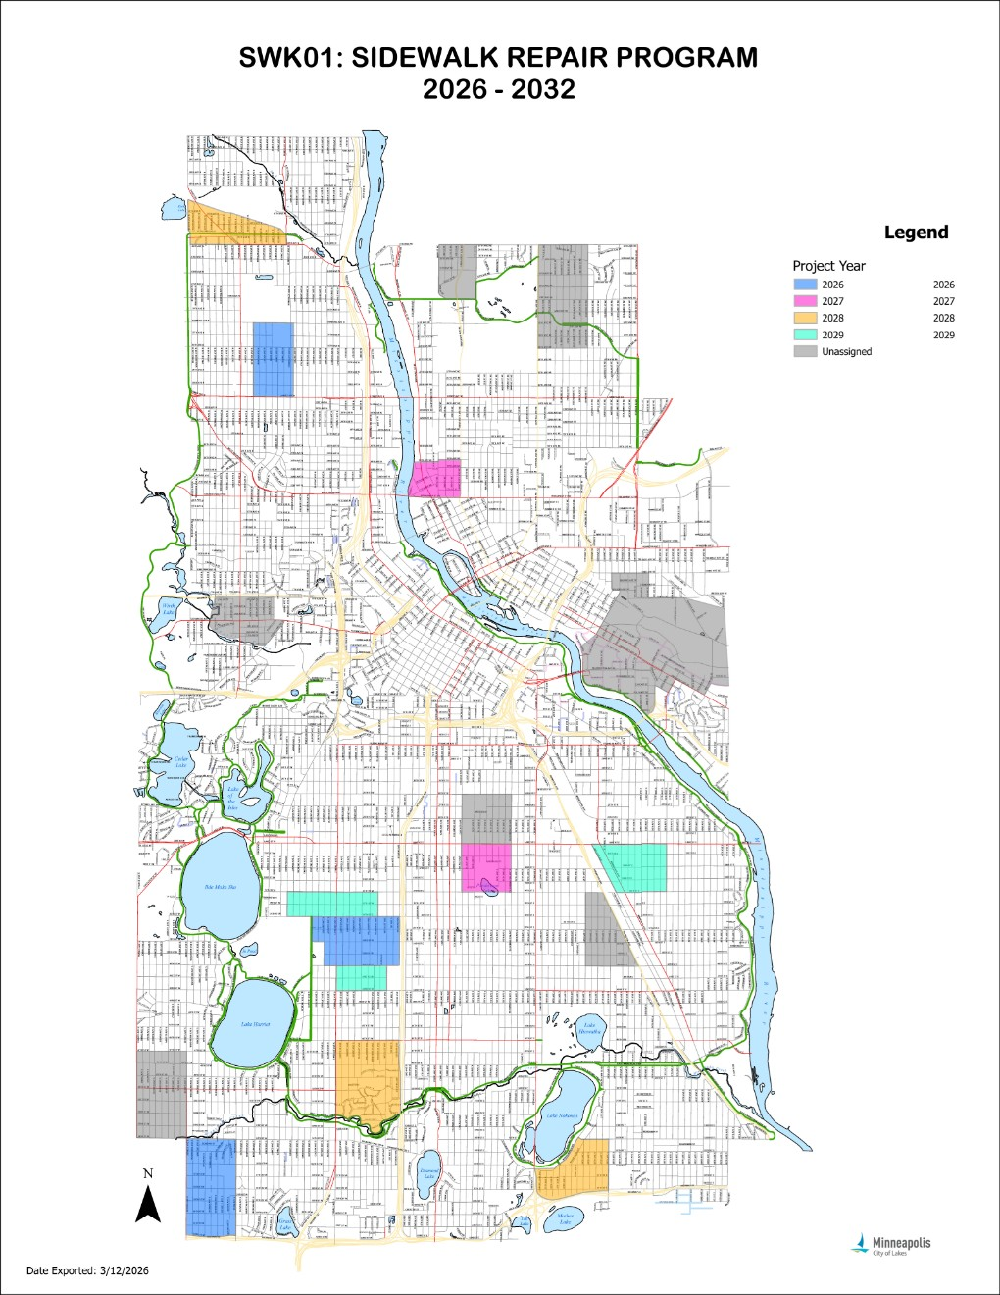
Future
Sidewalk Repair Program
Notes:
Add future area map

Slide 13
Contacts
Who to contact if:
  There are questions about the sidewalk panels we have marked for replacement.
  There are footprints in fresh concrete
  There is damage to private property caused by the contractor
  Anything else you can think of related to the new sidewalk panels
  Sidewalk Inspector Charlie Cox 612-463-1571
  Sidewalk Supervisor Brandon Schnabel 612-704-7092
  PWSidewalkInspections@minneapolismn.gov

